Slide 1
HKUST · MSc(AIE) Program · Fall 2026/27
Artificial Intelligence Ethics
MAIE 5103 · No. of Credits: 3
Instructor: HAN, Sirui
Email: siruihan@ust.hk
Office Hours: TBD
Learn to recognize ethical risks before they become real-world harms.
Course Overview & Lecture 1: Introduction to AI Ethics
1
Notes:
Learn to recognize ethical risks before they become real-world harms. Use the visible source material on this slide to explain the idea in concrete terms, then connect it to the next step in the lecture. Invite students to test the claim against a familiar AI system rather than treating the principle as an abstract slogan.
[Sources]
- Source content and course structure: user-provided MAIE5103_Lecture1_all.pptx.

Slide 2
Welcome & Instructor Introduction
A case-driven, discussion-based course on the ethics of AI.
We investigate how AI systems are designed, developed, and deployed — and the societal impacts that follow.
About the instructor: Sirui Han (research & teaching interests to be confirmed).
Contact: siruihan@ust.hk · Office hours: TBD (announced via Canvas).
Reach me by email; please allow ~2 business days for a reply.
This course connects technical design choices to their consequences for people and institutions.
MAIE 5103 · Artificial Intelligence Ethics
2
2
Notes:
This course connects technical design choices to their consequences for people and institutions. Use the visible source material on this slide to explain the idea in concrete terms, then connect it to the next step in the lecture. Invite students to test the claim against a familiar AI system rather than treating the principle as an abstract slogan.
[Sources]
- Source content and course structure: user-provided MAIE5103_Lecture1_all.pptx.

Slide 3
Today's Agenda
Part 1 — Course Overview
Objectives, weekly schedule, assessments, and course policies
Break
(~10 min)
Part 2 — Lecture 1: Introduction to AI Ethics
What is AI? What is ethics? Why does it matter now? (~50 min)
Q&A — throughout and at the end
We first establish how the course works, then build a practical vocabulary for ethical reasoning.
MAIE 5103 · Artificial Intelligence Ethics
3
3
Notes:
We first establish how the course works, then build a practical vocabulary for ethical reasoning. Use the visible source material on this slide to explain the idea in concrete terms, then connect it to the next step in the lecture. Invite students to test the claim against a familiar AI system rather than treating the principle as an abstract slogan.
[Sources]
- Source content and course structure: user-provided MAIE5103_Lecture1_all.pptx.

Slide 4
Course Description
This course delves into the ethical considerations involved in designing, developing, and deploying artificial intelligence (AI) systems. Students will investigate the societal impacts of AI and the ethical dilemmas that emerge in areas such as privacy, bias, transparency, and accountability. Through case studies and discussions, students will build a framework for ethical decision-making in the development and implementation of AI systems.
Key themes this term: privacy & data protection · fairness & bias · accountability & transparency · safety & security · societal impact · AI policy & regulation.
Ethical analysis follows AI across research, design, deployment, use, and governance.
MAIE 5103 · Artificial Intelligence Ethics
4
4
Notes:
Ethical analysis follows AI across research, design, deployment, use, and governance. Use the visible source material on this slide to explain the idea in concrete terms, then connect it to the next step in the lecture. Invite students to test the claim against a familiar AI system rather than treating the principle as an abstract slogan.
[Sources]
- Source content and course structure: user-provided MAIE5103_Lecture1_all.pptx.

Slide 5
Why This Course Matters
AI is now pervasive and high-stakes — it shapes credit, hiring, healthcare, criminal justice, and democracy.
Ethical harms are already happening: biased decisions, privacy erosion, misinformation, surveillance.
Ethics must be part of design, not an afterthought.
Over the term we examine real cases, e.g.:
Recidivism risk scoring (COMPAS)
Public-service algorithms that profile the poor (Eubanks)
Facial recognition & surveillance; deepfakes; autonomous systems.
Automated decisions increasingly shape access to opportunities, services, rights, and public trust.
MAIE 5103 · Artificial Intelligence Ethics
5
5
Notes:
Automated decisions increasingly shape access to opportunities, services, rights, and public trust. Use the visible source material on this slide to explain the idea in concrete terms, then connect it to the next step in the lecture. Invite students to test the claim against a familiar AI system rather than treating the principle as an abstract slogan.
[Sources]
- Source content and course structure: user-provided MAIE5103_Lecture1_all.pptx.

Slide 6
Course Intended Learning Outcomes (CILOs)
On successful completion of this course, students will be able to:
CILO-1 Acquire a comprehensive understanding of AI ethical considerations and social implications.
CILO-2 Develop own perspectives on the foundational ethical questions surrounding emerging technologies.
CILO-3 Critically analyze impacts and societal challenges of AI.
CILO-4 Apply knowledge to real-world AI-related issues and propose solutions.
CILO-5 Enhance written and oral communication skills to effectively discuss ideas related to AI ethics.
Mapping: CILOs map onto assessments (e.g., Reading response → CILO 1, 2, 5; Final project → all) and onto weekly lectures.
The goal is not only to know ethical concepts, but to evaluate, communicate, and act on them.
MAIE 5103 · Artificial Intelligence Ethics
6
6
Notes:
The goal is not only to know ethical concepts, but to evaluate, communicate, and act on them. Use the visible source material on this slide to explain the idea in concrete terms, then connect it to the next step in the lecture. Invite students to test the claim against a familiar AI system rather than treating the principle as an abstract slogan.
[Sources]
- Source content and course structure: user-provided MAIE5103_Lecture1_all.pptx.

Slide 7
Course Structure: A 13-Week Journey
The course unfolds in four phases, building from foundations to a capstone project.
Phase | Weeks | Focus
Foundations | 1 – 3 | Introduction to AI Ethics · Privacy & Data Protection · Accountability, Responsibility & Transparency
Fairness & Bias | 4 – 7 | Fairness and Bias (Parts 1–2) · Beyond Bias (Parts 1–2) + Tutorials on Academic Writing & News Presentation
Applications & Governance | 8 – 11 | Ethics of Automation · Safety & Security · AI in Social Media · AI in Military & Politics · AI Policy & Regulations
Capstone | 12 – 13 | Final Project Presentations
Each phase builds toward an evidence-based capstone analysis of a real AI ethics problem.
MAIE 5103 · Artificial Intelligence Ethics
7
7
Notes:
Each phase builds toward an evidence-based capstone analysis of a real AI ethics problem. Use the visible source material on this slide to explain the idea in concrete terms, then connect it to the next step in the lecture. Invite students to test the claim against a familiar AI system rather than treating the principle as an abstract slogan.
[Sources]
- Source content and course structure: user-provided MAIE5103_Lecture1_all.pptx.

Slide 8
Weekly Schedule
Order and contents may be adjusted according to teaching progress.
Week | Topic
1 | Course Overview & Lecture 1: Introduction to AI Ethics
2 | Lecture 2: Privacy and Data Protection
3 | Lecture 3: Accountability, Responsibility, Transparency
4 | Lecture 4: Fairness and Bias (Part 1) & Tutorial on Academic Writing
5 | Lecture 4: Fairness and Bias (Part 2)
6 | Lecture 5: Beyond Bias (Part 1) & Tutorial on News Presentation
7 | Lecture 5: Beyond Bias (Part 2)
8 | Lecture 6: The Ethics of Automation & Lecture 7: Safety and Security
9 | Lecture 8: AI in Social Media
10 | Lecture 9: AI in the Military & Lecture 10: AI in Politics
11 | Lecture 11: AI Policy and Regulations
12 | Final Project Presentations
13 | Final Project Presentations
The semester moves from foundations to recurring issues, applied domains, and governance.
MAIE 5103 · Artificial Intelligence Ethics
8
8
Notes:
The semester moves from foundations to recurring issues, applied domains, and governance. Use the visible source material on this slide to explain the idea in concrete terms, then connect it to the next step in the lecture. Invite students to test the claim against a familiar AI system rather than treating the principle as an abstract slogan.
[Sources]
- Source content and course structure: user-provided MAIE5103_Lecture1_all.pptx.

Slide 9
Assessments Overview
Criterion-referenced grading; letter grades assigned against descriptors (not curved).
Assessment Task | Weight | Due Date | Mapped CILOs
Participation | 20% | In class | 3, 4, 5
Quizzes (4 in total) | 10% | In class | 1, 2, 3
AI news presentation (Individual) | 10% | ~ End of October | 2, 3, 4
Reading response (Individual) | 15% | ~ Mid-October | 1, 2, 5
Case study analysis (Individual) | 15% | ~ Mid-November | 3, 4, 5
Final project report (Group) | 15% | ~ Early December | 1 – 5
Final project presentation (Group) | 15% | In class (Wk 12–13) | 1 – 5
Total | 100%
The assessment mix rewards preparation, analysis, communication, and integrated project work.
MAIE 5103 · Artificial Intelligence Ethics
9
9
Notes:
The assessment mix rewards preparation, analysis, communication, and integrated project work. Use the visible source material on this slide to explain the idea in concrete terms, then connect it to the next step in the lecture. Invite students to test the claim against a familiar AI system rather than treating the principle as an abstract slogan.
[Sources]
- Source content and course structure: user-provided MAIE5103_Lecture1_all.pptx.

Slide 10
Assessment Details (1)
Participation · Quizzes · AI News Presentation · Reading Response
Participation (20%)
Attendance + engaged discussion; bring the readings and contribute regularly.
Quizzes (10% — 4 in-class)
Short, based on the weekly readings; held in Weeks 4, 7, 9, and 11.
AI News Presentation (10%, individual, ~ end-Oct)
Present a significant recent AI news event (5–8 min); rubric on clarity, fact accuracy, and newsworthy analysis.
Reading Response (15%, individual, ~ mid-Oct)
Critical written response to one reading from the Readings Pool; rubric on clarity, use of readings, critique, and citation.
Strong work is prepared, evidence-based, concise, and explicitly connected to ethical concepts.
MAIE 5103 · Artificial Intelligence Ethics
10
10
Notes:
Strong work is prepared, evidence-based, concise, and explicitly connected to ethical concepts. Use the visible source material on this slide to explain the idea in concrete terms, then connect it to the next step in the lecture. Invite students to test the claim against a familiar AI system rather than treating the principle as an abstract slogan.
[Sources]
- Source content and course structure: user-provided MAIE5103_Lecture1_all.pptx.

Slide 11
Assessment Details (2)
Case Study Analysis · Final Project (Report + Presentation)
Case Study Analysis (15%, individual, ~ mid-Nov)
Analyze a real-world AI ethics case from the Case Study Pool; rubric on clarity, source support & fact accuracy, introduction, analysis, citation.
Final Project — Report (15%, group, ~ early-Dec)
In-depth group project on an AI ethics issue; rubric on clarity & organization, introduction, main body, accomplishments, recommendations, use of techniques/literature, citation.
Final Project — Presentation (15%, group, Wk 12–13)
Present the project in class; rubric on demonstration, clarity, organization & timing, audience engagement, slides, and Q&A.
The case study diagnoses an existing problem; the final project develops and defends a response.
MAIE 5103 · Artificial Intelligence Ethics
11
11
Notes:
The case study diagnoses an existing problem; the final project develops and defends a response. Use the visible source material on this slide to explain the idea in concrete terms, then connect it to the next step in the lecture. Invite students to test the claim against a familiar AI system rather than treating the principle as an abstract slogan.
[Sources]
- Source content and course structure: user-provided MAIE5103_Lecture1_all.pptx.

Slide 12
Required Texts & Weekly Readings
All available in HKUST library online resources or book collections.
Dignum, V. Responsible Artificial Intelligence: How to Develop and Use AI in a Responsible Way. Springer, 2019.
Coeckelbergh, M. AI Ethics. MIT Press, 2020.
Dubber, M. D., Pasquale, F. & Das, S. (Eds.). The Oxford Handbook of Ethics of AI. Oxford University Press, 2020.
Eubanks, V. Automating Inequality: How High-Tech Tools Profile, Police, and Punish the Poor. St. Martin’s Press, 2018.
O’Neil, C. Weapons of Math Destruction: How Big Data Increases Inequality and Threatens Democracy. Crown, 2016.
Every week, a list of readings will be provided and released on Canvas as additional resources.
The readings combine philosophy, responsible-AI practice, mathematical harms, and social impact.
MAIE 5103 · Artificial Intelligence Ethics
12
12
Notes:
The readings combine philosophy, responsible-AI practice, mathematical harms, and social impact. Use the visible source material on this slide to explain the idea in concrete terms, then connect it to the next step in the lecture. Invite students to test the claim against a familiar AI system rather than treating the principle as an abstract slogan.
[Sources]
- Source content and course structure: user-provided MAIE5103_Lecture1_all.pptx.

Slide 13
Academic Integrity & Course AI Policy
Academic Integrity
Uphold HKUST’s Academic Honor Code; the University has zero tolerance for academic misconduct.
Plagiarism = presenting others’ work or ideas as your own without attribution. Refer to HKUST Academic Registry guidance.
Course AI Policy
You may use generative AI as a collaborator (e.g., to aid searching), but all interactions must be credited in the assignment.
AI may support learning only when its use is permitted, disclosed, verified, and remains your own work.
MAIE 5103 · Artificial Intelligence Ethics
13
13
Notes:
AI may support learning only when its use is permitted, disclosed, verified, and remains your own work. Use the visible source material on this slide to explain the idea in concrete terms, then connect it to the next step in the lecture. Invite students to test the claim against a familiar AI system rather than treating the principle as an abstract slogan.
[Sources]
- Source content and course structure: user-provided MAIE5103_Lecture1_all.pptx.

Slide 14
Logistics, Communication & How to Succeed
Canvas is the hub: readings, announcements, grades, and submissions.
Office hours: TBD — email siruihan@ust.hk (~2 business days reply).
Late work: not accepted without prior arrangement and supporting documents.
How to succeed:
Do the weekly readings before class.
Speak up in discussions — participation counts 20%.
Start the final project early; form your group early.
Build your own ethical voice over the term.
A reliable weekly rhythm is simple: read, contribute, reflect, and ask for help early.
MAIE 5103 · Artificial Intelligence Ethics
14
14
Notes:
A reliable weekly rhythm is simple: read, contribute, reflect, and ask for help early. Use the visible source material on this slide to explain the idea in concrete terms, then connect it to the next step in the lecture. Invite students to test the claim against a familiar AI system rather than treating the principle as an abstract slogan.
[Sources]
- Source content and course structure: user-provided MAIE5103_Lecture1_all.pptx.

Slide 15
PART B · LECTURE 1
Introduction to AI Ethics
What is AI, what is ethics, and why does it matter now?
To judge AI responsibly, we need to understand both the technology and the values it affects.
MAIE 5103 · Artificial Intelligence Ethics
15
15
Notes:
To judge AI responsibly, we need to understand both the technology and the values it affects. Use the visible source material on this slide to explain the idea in concrete terms, then connect it to the next step in the lecture. Invite students to test the claim against a familiar AI system rather than treating the principle as an abstract slogan.
[Sources]
- Source content and course structure: user-provided MAIE5103_Lecture1_all.pptx.

Slide 16
Lecture 1 Outline
Today's roadmap — seven sections.
01 What is AI? — definitions, history, how modern AI works
02 What is ethics? — ethics vs law; major ethical theories
03 What is AI ethics & why now? — scope, urgency, actors
04 Key AI ethics issues — fairness, privacy, transparency, accountability, safety, impact
05 Case studies — criminal justice, public services, hiring, surveillance, deepfakes
06 Frameworks & decision-making — Responsible AI, principles, trade-offs, a method
07 Wrap-up — takeaways, reading, next lecture, Q&A
DEFINE
EVALUATE
APPLY
The lecture progresses from definition to evaluation, cases, and practical decision-making.
MAIE 5103 · Artificial Intelligence Ethics
16
16
Notes:
The lecture progresses from definition to evaluation, cases, and practical decision-making. Use the visible source material on this slide to explain the idea in concrete terms, then connect it to the next step in the lecture. Invite students to test the claim against a familiar AI system rather than treating the principle as an abstract slogan.
[Sources]
- Source content and course structure: user-provided MAIE5103_Lecture1_all.pptx.

Slide 17
Lecture 1 Learning Objectives
By the end of this session, you should be able to…
DISTINGUISH
APPLY
descriptive, normative, and technical questions
multiple ethical lenses to the same case
MAP
JUSTIFY
stakeholders, values, benefits, and harms
a provisional decision and safeguards
Ethical competence means moving from recognition to reasoned action.
MAIE 5103 · Artificial Intelligence Ethics
17
Notes:
Use these objectives as a contract for the session. Students should leave able to identify the kind of ethical question being asked, use more than one lens, map who is affected, and defend a practical response.
[Sources]
- Source course structure and baseline content: user-provided MAIE5103_Lecture1_all.pptx.

Slide 18
Opening Poll: Where Did AI Decide for You Today?
Think individually for 30 seconds, then compare with a partner.
MEDIA
FINANCE
EDUCATION
MOBILITY
HEALTH
PUBLIC SERVICES
Name the decision, the data it may use, and one person who could be affected.
MAIE 5103 · Artificial Intelligence Ethics
18
Notes:
Invite two or three examples. Push students beyond obvious chatbots: recommendations, ranking, fraud detection, navigation, admissions support, triage, and eligibility systems are all AI-mediated decisions. This opening makes the lecture immediately personal.
[Sources]
- Source course structure and baseline content: user-provided MAIE5103_Lecture1_all.pptx.

Slide 19
What is Artificial Intelligence?
Popular sense: machines performing tasks that typically require human intelligence.
Technical sense (Russell & Norvig): the study of rational agents that perceive and act.
Narrow (weak) AI: task-specific systems — spam filters, face ID, translation.
General (strong) AI: human-level ability across domains. We are far from AGI today.
Today’s AI ≈ pattern recognition from data at scale — not “thinking” in the human sense.
RULES
MACHINE LEARNING
GENERATIVE AI
Most current AI learns patterns for specific tasks; fluent or capable behavior is not human understanding.
MAIE 5103 · Artificial Intelligence Ethics
19
17
Notes:
Most current AI learns patterns for specific tasks; fluent or capable behavior is not human understanding. Use the visible source material on this slide to explain the idea in concrete terms, then connect it to the next step in the lecture. Invite students to test the claim against a familiar AI system rather than treating the principle as an abstract slogan.
[Sources]
- Source content and course structure: user-provided MAIE5103_Lecture1_all.pptx.

Slide 20
A Brief History of AI
AI is not new — but data + compute + methods made it explode.
1950 Turing Test — can a machine imitate human conversation?
1956 Dartmouth Workshop — the term “AI” is coined.
1970s–80s Symbolic AI & expert systems, then two “AI winters.”
2000s Machine learning rises as data and compute grow.
2012 Deep learning breakthrough (ImageNet).
2016 AlphaGo beats the world Go champion.
2020s Generative AI & LLMs (GPT, diffusion) — fluent text, images, code.
1950s
AI WINTERS
DEEP LEARNING
GENERATIVE AI
AI history repeatedly cycles through optimism, technical limits, and renewed progress driven by new methods and resources.
MAIE 5103 · Artificial Intelligence Ethics
20
18
Notes:
AI history repeatedly cycles through optimism, technical limits, and renewed progress driven by new methods and resources. Use the visible source material on this slide to explain the idea in concrete terms, then connect it to the next step in the lecture. Invite students to test the claim against a familiar AI system rather than treating the principle as an abstract slogan.
[Sources]
- Source content and course structure: user-provided MAIE5103_Lecture1_all.pptx.

Slide 21

AI History Is Also a History of Expectations
Capability changed—but so did the stories society told about AI.
1
1950s Foundational questions and symbolic ambition
2
1970s–90s AI winters expose limits in data, compute, and methods
3
2010s Deep learning scales pattern recognition
4
2020s Generative AI expands access—and expectations
Ethical analysis should separate demonstrated capability from hype, projection, and institutional incentives.
MAIE 5103 · Artificial Intelligence Ethics
21
Notes:
Use Turing as the starting point, then emphasize the recurring cycle: strong expectations, technical and institutional limits, new resources, and renewed confidence. Ethical judgment becomes distorted when imagined capability is treated as present fact.
[Sources]
- https://www.turing.ac.uk/people/researchers/idris-zakariyya

Slide 22
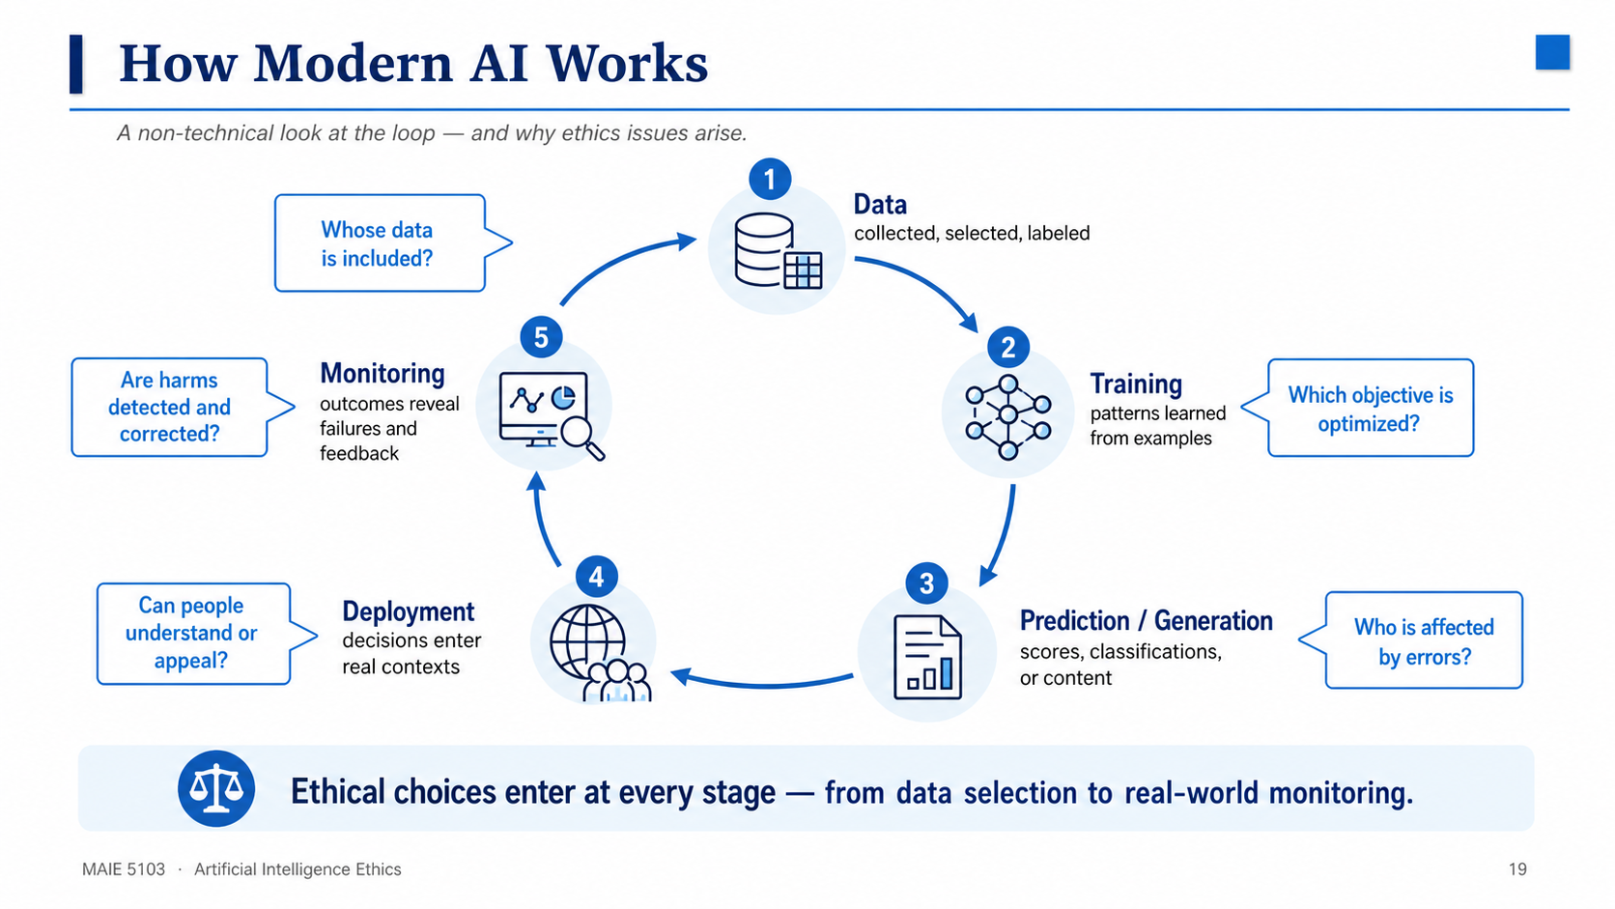
How Modern AI Works
A non-technical look at the loop — and why ethics issues arise.
The machine-learning loop
Data (collected, labeled) → Training → Prediction/Generation → Deployment
The model reflects its data — errors and biases propagate downstream.
Three families (brief): supervised (labels), unsupervised (patterns), reinforcement (rewards).
Ethical stakes enter at every stage: what data, whose labels, which objective, who is affected.
MAIE 5103 · Artificial Intelligence Ethics
22
19
Notes:
Walk through the lifecycle clockwise: data, training, prediction or generation, deployment, and monitoring. At each stage, ask the blue question beside it. The key point is that ethics is not a final compliance check; choices about inclusion, objectives, error, explanation, appeal, and correction enter throughout the system lifecycle.
[Sources]
- Source content and visual identity: user-provided MAIE5103_Lecture1_all.pptx.
- Slide artwork: Codex built-in image generation, approved by the user in this task.

Slide 23
Generative AI & Large Language Models
What it is
Trained on massive text; predicts the next token.
Generates fluent text (ChatGPT), images (diffusion), code, audio.
Emerging abilities: drafting, summarizing, translation, reasoning.
Limits relevant to ethics
Hallucination — confident falsehoods.
Non-determinism — different answers each run.
Memorizes & may leak training data.
No genuine understanding or grounding in the world.
PROMPT
TOKEN PREDICTION
FLUENT OUTPUT
VERIFY
Generative models can produce fluent outputs without knowing whether those outputs are true, fair, or appropriate.
MAIE 5103 · Artificial Intelligence Ethics
23
20
Notes:
Generative models can produce fluent outputs without knowing whether those outputs are true, fair, or appropriate. Use the visible source material on this slide to explain the idea in concrete terms, then connect it to the next step in the lecture. Invite students to test the claim against a familiar AI system rather than treating the principle as an abstract slogan.
[Sources]
- Source content and course structure: user-provided MAIE5103_Lecture1_all.pptx.

Slide 24
LLMs: Fluency, Knowledge, and Verification Are Different
A confident sentence can be useful, false, unsupported—or all three.
FLUENCY
KNOWLEDGE
VERIFICATION
The output follows linguistic patterns and sounds coherent.
The model may reproduce useful associations, but it does not guarantee grounded understanding.
Claims still need evidence, provenance, context, and an accountable reviewer.
Treat fluency as a presentation property—not as proof of truth or understanding.
MAIE 5103 · Artificial Intelligence Ethics
24
Notes:
Walk left to right. Fluency describes the surface quality of language. Knowledge is more contested and depends on what kind of representation or competence we mean. Verification is a social and technical process outside the generated sentence.
[Sources]
- Source course structure and baseline content: user-provided MAIE5103_Lecture1_all.pptx.

Slide 25
Mini Activity: Test a Generative-AI Answer
Read the answer, then audit it instead of merely reacting to it.
Sample answer: “This hiring model is fair because it does not use gender as an input.”
1
2
What factual evidence is offered?
Which assumptions are hidden?
3
4
Whose perspective is missing?
What would you verify before acting?
A responsible user turns an answer into a set of verification tasks.
MAIE 5103 · Artificial Intelligence Ethics
25
Notes:
Give students two minutes in pairs. The key issue is that excluding gender does not remove gendered proxies or unequal outcomes. Ask groups to name evidence they would request: subgroup performance, feature documentation, data provenance, audit results, and appeal procedures.
[Sources]
- Source course structure and baseline content: user-provided MAIE5103_Lecture1_all.pptx.

Slide 26
Where AI is Deployed Today
AI is already in the infrastructure of daily life.
Search & recommendation — what we see, read, and buy
Social media — feeds, moderation, engagement
Finance & credit — scoring, lending, insurance
Hiring & HR — resumé screening, monitoring
Healthcare — diagnosis, triage, allocation
Criminal justice — risk scoring, policing
Autonomous systems — vehicles, drones
Creative industries — text, image, music generation
MEDIA
FINANCE
HEALTH
GOVERNMENT
AI is often invisible infrastructure: it ranks, recommends, predicts, allocates, and moderates throughout daily life.
MAIE 5103 · Artificial Intelligence Ethics
26
21
Notes:
AI is often invisible infrastructure: it ranks, recommends, predicts, allocates, and moderates throughout daily life. Use the visible source material on this slide to explain the idea in concrete terms, then connect it to the next step in the lecture. Invite students to test the claim against a familiar AI system rather than treating the principle as an abstract slogan.
[Sources]
- Source content and course structure: user-provided MAIE5103_Lecture1_all.pptx.

Slide 27
Capabilities, Limits & Uncertainties
High confidence ≠ reliability.
Strengths
Pattern recognition at vast scale.
Speed and consistency beyond human capacity.
Performance on well-defined, data-rich tasks.
Limits
Brittleness — fails on distribution shift.
Hallucination & lack of causal understanding.
Non-reproducibility; vulnerable to adversarial inputs.
CAPABILITY
CONTEXT
UNCERTAINTY
Benchmark performance is conditional; context change, uncertainty, and adversarial use can quickly undermine reliability.
MAIE 5103 · Artificial Intelligence Ethics
27
22
Notes:
Benchmark performance is conditional; context change, uncertainty, and adversarial use can quickly undermine reliability. Use the visible source material on this slide to explain the idea in concrete terms, then connect it to the next step in the lecture. Invite students to test the claim against a familiar AI system rather than treating the principle as an abstract slogan.
[Sources]
- Source content and course structure: user-provided MAIE5103_Lecture1_all.pptx.

Slide 28
From AI to AI Ethics
The bridge into Part 2.
Powerful + Opaque + Pervasive = ethics cannot be an afterthought.
Power: high-stakes decisions over people’s lives.
Opacity: many models are black boxes — hard to inspect or explain.
Pervasiveness: billions are affected, often without knowing.
POWER
OPACITY
SCALE
Powerful + opaque + pervasive systems create obligations to anticipate, explain, and remedy harm.
MAIE 5103 · Artificial Intelligence Ethics
28
23
Notes:
Powerful + opaque + pervasive systems create obligations to anticipate, explain, and remedy harm. Use the visible source material on this slide to explain the idea in concrete terms, then connect it to the next step in the lecture. Invite students to test the claim against a familiar AI system rather than treating the principle as an abstract slogan.
[Sources]
- Source content and course structure: user-provided MAIE5103_Lecture1_all.pptx.

Slide 29
MAIE 5103 · LECTURE 1
Break 1
Return question: Where in the AI lifecycle would you intervene first—and why?
15–20 MINUTES
MAIE 5103 · Artificial Intelligence Ethics
29
Notes:
Take a 15–20 minute break. Keep the return question visible so students re-enter the room already considering intervention points.
[Sources]
- Source course structure and baseline content: user-provided MAIE5103_Lecture1_all.pptx.

Slide 30
What is Ethics?
Ethics: systematic reflection on what is right/good and why.
Morality = the beliefs and standards people actually hold; ethics = the reasoned study of them.
Law = the enforceable minimum floor; ethics may demand more, or forbid what law allows.
Descriptive ethics: what people believe.
Normative ethics: what they ought to do.
LAW
MORALITY
ETHICS
Law asks what is permitted; ethics asks what is justified and why, including when law is silent.
MAIE 5103 · Artificial Intelligence Ethics
30
24
Notes:
Law asks what is permitted; ethics asks what is justified and why, including when law is silent. Use the visible source material on this slide to explain the idea in concrete terms, then connect it to the next step in the lecture. Invite students to test the claim against a familiar AI system rather than treating the principle as an abstract slogan.
[Sources]
- Source content and course structure: user-provided MAIE5103_Lecture1_all.pptx.

Slide 31
Why Ethics for Technology?
Technology is never neutral.
“Tools shape how we perceive and act” — the mediation thesis (Coeckelbergh).
Every design choice embodies values — what is optimized, whose interests count.
A news feed optimizes engagement; a risk model optimizes a proxy for risk.
So ethics must be by design, not bolted on after the harm.
OBJECTIVE
DESIGN CHOICE
BEHAVIOR
OUTCOME
Technology is not neutral because every objective, interface, and default privileges some values over others.
MAIE 5103 · Artificial Intelligence Ethics
31
25
Notes:
Technology is not neutral because every objective, interface, and default privileges some values over others. Use the visible source material on this slide to explain the idea in concrete terms, then connect it to the next step in the lecture. Invite students to test the claim against a familiar AI system rather than treating the principle as an abstract slogan.
[Sources]
- Source content and course structure: user-provided MAIE5103_Lecture1_all.pptx.

Slide 32
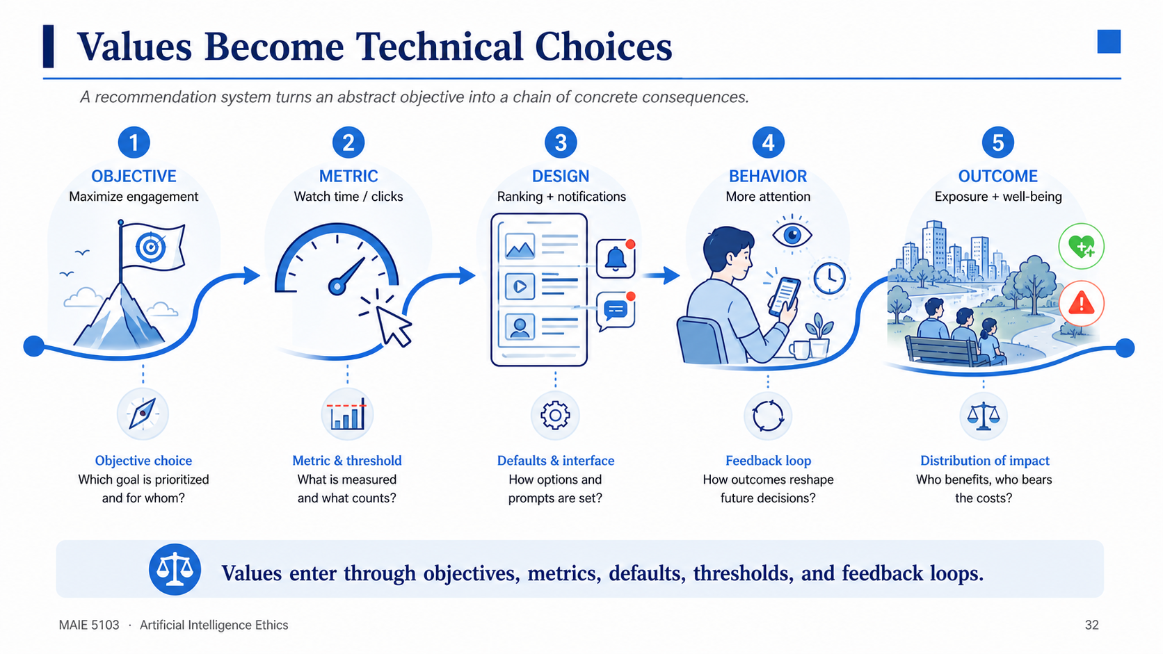
Notes:
Use recommendation as a familiar example. The point is not that engagement is always wrong, but that choosing it as the dominant objective makes a normative claim about what the system should optimize.
• Changing the metric changes which content is promoted.
• Interface defaults affect autonomy and attention.
• The same objective distributes benefits and burdens unevenly

Slide 33
Ethical Lens 1: Consequentialism / Utilitarianism
Judge acts by their consequences; maximize overall well-being (Bentham, Mill).
In AI: optimize a measurable objective — accuracy, profit, safety.
Strength: pragmatic; fits cost–benefit reasoning.
Weakness: “good” is hard to quantify; minorities can be sacrificed for the average.
BENEFITS
HARMS
DISTRIBUTION
Consequentialism asks whose benefits and harms count, over what time horizon, and under what uncertainty.
MAIE 5103 · Artificial Intelligence Ethics
33
26
Notes:
Consequentialism asks whose benefits and harms count, over what time horizon, and under what uncertainty. Use the visible source material on this slide to explain the idea in concrete terms, then connect it to the next step in the lecture. Invite students to test the claim against a familiar AI system rather than treating the principle as an abstract slogan.
[Sources]
- Source content and course structure: user-provided MAIE5103_Lecture1_all.pptx.

Slide 34
Ethical Lens 2: Deontology
Some acts are right/wrong regardless of outcomes — grounded in duties, rights, consent.
Kant: treat persons as ends, not merely means.
In AI: consent, privacy, and human rights act as constraints on optimization.
Strength: protects individuals and minorities.
Weakness: rigid when values genuinely conflict.
RIGHTS
DUTIES
CONSENT
A high-performing system can still be wrong if it violates rights, consent, dignity, or due process.
MAIE 5103 · Artificial Intelligence Ethics
34
27
Notes:
A high-performing system can still be wrong if it violates rights, consent, dignity, or due process. Use the visible source material on this slide to explain the idea in concrete terms, then connect it to the next step in the lecture. Invite students to test the claim against a familiar AI system rather than treating the principle as an abstract slogan.
[Sources]
- Source content and course structure: user-provided MAIE5103_Lecture1_all.pptx.

Slide 35
Ethical Lens 3: Virtue & Relational Ethics
Virtue ethics: not “what act?” but what kind of agent/designer? (responsibility, humility, care).
Relational ethics (Coeckelbergh): moral meaning arises in human–technology relations, not just abstract rules.
Focus shifts to the character and relationships behind the technology.
Especially apt for AI that mediates trust, care, and attention.
CHARACTER
CARE
RELATIONSHIPS
Virtue and relational ethics shift attention from isolated acts to character, care, dependence, and social context.
MAIE 5103 · Artificial Intelligence Ethics
35
28
Notes:
Virtue and relational ethics shift attention from isolated acts to character, care, dependence, and social context. Use the visible source material on this slide to explain the idea in concrete terms, then connect it to the next step in the lecture. Invite students to test the claim against a familiar AI system rather than treating the principle as an abstract slogan.
[Sources]
- Source content and course structure: user-provided MAIE5103_Lecture1_all.pptx.

Slide 36
Other Lenses & When to Use Which
Justice (Rawls): fair distribution; design to favor the least advantaged.
Care ethics: relationships, vulnerability, dependence.
Rights-based: human rights as side-constraints on design.
Principlism: autonomy, beneficence, non-maleficence, justice.
No single lens suffices — use several; they illuminate different facets of a problem.
JUSTICE
CARE
RIGHTS
CAPABILITIES
Different lenses expose different blind spots; robust analysis usually needs more than one.
MAIE 5103 · Artificial Intelligence Ethics
36
29
Notes:
Different lenses expose different blind spots; robust analysis usually needs more than one. Use the visible source material on this slide to explain the idea in concrete terms, then connect it to the next step in the lecture. Invite students to test the claim against a familiar AI system rather than treating the principle as an abstract slogan.
[Sources]
- Source content and course structure: user-provided MAIE5103_Lecture1_all.pptx.

Slide 37
One Case, Four Ethical Lenses
Case: an AI hiring tool ranks applicants before any human review.
CONSEQUENCES
DUTIES & RIGHTS
JUSTICE
CARE
Do benefits outweigh harms across all groups?
Are consent, dignity, and due process respected?
Are opportunities and burdens distributed fairly?
Who is vulnerable or dependent on the decision?
The lenses do not merely produce different words; they direct attention to different evidence and obligations.
MAIE 5103 · Artificial Intelligence Ethics
37
Notes:
Apply each lens to the same tool. Encourage students to notice that a favorable aggregate outcome does not settle rights, distribution, or care concerns. Multiple lenses reduce the risk of a one-dimensional conclusion.
[Sources]
- Source course structure and baseline content: user-provided MAIE5103_Lecture1_all.pptx.

Slide 38
Small-Group Lens Exercise
Prepare a one-minute recommendation using only your assigned lens.
1
Identify the key ethical question
2
Request the evidence your lens needs
3
Recommend deploy, redesign, audit, or stop
4
Name one weakness in your own analysis
Report back with a claim, the evidence required, and a limitation—not a slogan.
MAIE 5103 · Artificial Intelligence Ethics
38
Notes:
Assign consequentialism, deontology, justice, or care ethics to groups. Allow four minutes to prepare and about four minutes for selected report-backs. Ask each group to state what evidence could change its recommendation.
[Sources]
- Source course structure and baseline content: user-provided MAIE5103_Lecture1_all.pptx.

Slide 39
What is AI Ethics?
Definition & scope.
AI ethics: the critical study of moral issues arising in AI research, design, deployment, and governance (Dignum; Oxford Handbook).
Adjacent fields overlap but differ: data ethics, robot ethics, computer ethics.
Four levels: research integrity → responsible design → deployment context → governance.
DESIGN
DEPLOYMENT
GOVERNANCE
AI ethics studies moral questions across the full socio-technical lifecycle, not only model behavior.
MAIE 5103 · Artificial Intelligence Ethics
39
30
Notes:
AI ethics studies moral questions across the full socio-technical lifecycle, not only model behavior. Use the visible source material on this slide to explain the idea in concrete terms, then connect it to the next step in the lecture. Invite students to test the claim against a familiar AI system rather than treating the principle as an abstract slogan.
[Sources]
- Source content and course structure: user-provided MAIE5103_Lecture1_all.pptx.

Slide 40
What Counts as an “AI Ethics Issue”?
Is (descriptive)
Does this model discriminate?
Ought (normative)
Should we deploy it?
How (technical)
What safeguards & redress?
IS?
OUGHT?
HOW?
AI ethics spans all three — description, judgment, and method.
A complete analysis combines descriptive evidence, normative judgment, and practical safeguards.
MAIE 5103 · Artificial Intelligence Ethics
40
31
Notes:
A complete analysis combines descriptive evidence, normative judgment, and practical safeguards. Use the visible source material on this slide to explain the idea in concrete terms, then connect it to the next step in the lecture. Invite students to test the claim against a familiar AI system rather than treating the principle as an abstract slogan.
[Sources]
- Source content and course structure: user-provided MAIE5103_Lecture1_all.pptx.

Slide 41
Why AI Ethics, Why Now?
Four structural reasons.
Scale: billions affected, often simultaneously.
Opacity: models are black boxes — hard to inspect or explain.
Speed: rapid, iterative deployment outpaces reflection.
Stakes: decisions over credit, health, liberty, and democracy.
Plus: rising public concern and the first wave of regulation.
SCALE
OPACITY
SPEED
STAKES
Scale, opacity, speed, and high stakes make after-the-fact review too slow and too costly.
MAIE 5103 · Artificial Intelligence Ethics
41
32
Notes:
Scale, opacity, speed, and high stakes make after-the-fact review too slow and too costly. Use the visible source material on this slide to explain the idea in concrete terms, then connect it to the next step in the lecture. Invite students to test the claim against a familiar AI system rather than treating the principle as an abstract slogan.
[Sources]
- Source content and course structure: user-provided MAIE5103_Lecture1_all.pptx.

Slide 42
O’Neil’s “Weapons of Math Destruction”
A working framework for harmful algorithms (O’Neil, 2016).
A WMD = Opaque + at Scale + Damaging.
Opacity: the affected cannot see how decisions are made.
Scale: applied to many people at once.
Damage: errors cause real, often irreversible harm.
Proxies: models substitute stand-ins (e.g., zip code for risk) for what they can’t measure.
Feedback loops: predictions drive actions that become new data, reinforcing the model.
OPAQUE
AT SCALE
DAMAGING
Opaque, scaled, damaging systems often reinforce themselves through feedback loops.
MAIE 5103 · Artificial Intelligence Ethics
42
33
Notes:
Opaque, scaled, damaging systems often reinforce themselves through feedback loops. Use the visible source material on this slide to explain the idea in concrete terms, then connect it to the next step in the lecture. Invite students to test the claim against a familiar AI system rather than treating the principle as an abstract slogan.
[Sources]
- Source content and course structure: user-provided MAIE5103_Lecture1_all.pptx.

Slide 43
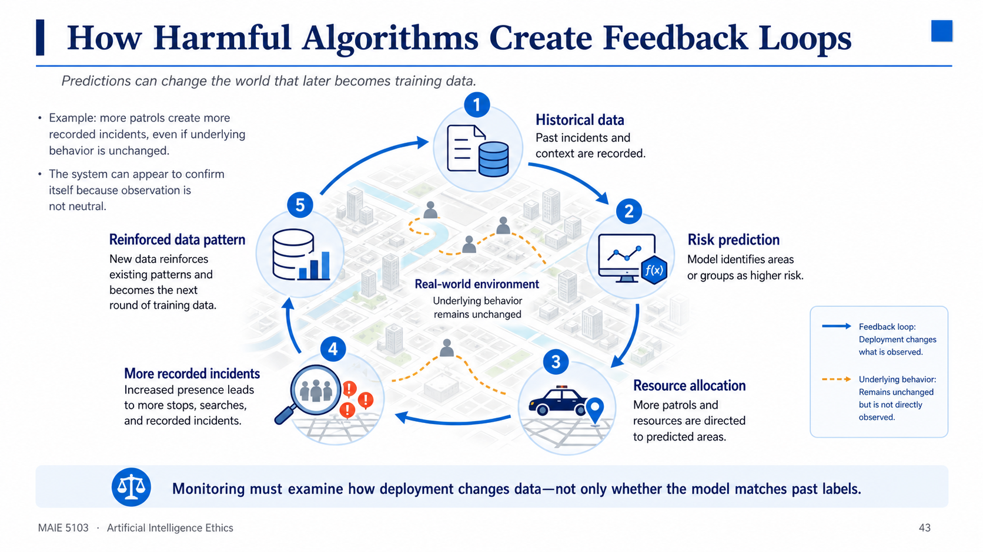
Notes:
Explain the clockwise feedback loop: historical records influence prediction, prediction changes resource allocation, deployment changes observation, and recorded incidents become future training data.
Use predictive policing as a conceptual example without claiming a particular numerical effect. Follow the loop and ask where intervention is possible: data interpretation, allocation policy, independent outcome measures, or deployment limits.
• Example: more patrols create more recorded incidents, even if underlying behavior is unchanged.
• The system can appear to confirm itself because observation is not neutral.

Slide 44
The AI Ethics Landscape
A growing ecosystem of actors.
Researchers & academics: concepts, methods, critique.
Industry: AI-ethics and AI-safety teams; responsible-AI programs.
Governments & regulators: emerging rules and risk-based frameworks.
Civil society: advocacy, audits, affected communities.
Standards bodies: OECD, UNESCO, IEEE — principles and standards.
From principles → slowly → enforceable practice.
RESEARCH
INDUSTRY
GOVERNMENT
COMMUNITIES
No single actor controls the full lifecycle, so effective governance must coordinate multiple forms of expertise and authority.
MAIE 5103 · Artificial Intelligence Ethics
44
34
Notes:
No single actor controls the full lifecycle, so effective governance must coordinate multiple forms of expertise and authority. Use the visible source material on this slide to explain the idea in concrete terms, then connect it to the next step in the lecture. Invite students to test the claim against a familiar AI system rather than treating the principle as an abstract slogan.
[Sources]
- Source content and course structure: user-provided MAIE5103_Lecture1_all.pptx.

Slide 45
Stakeholders & Responsibilities
The “many hands” problem (Dignum).
The pipeline: data providers → developers → deployers → users → affected communities → regulators.
Responsibility is distributed — and gaps enable evasion (“no one is responsible”).
Dignum’s framing: Responsible AI = who is responsible + what we design + how we govern.
DATA
DEVELOP
DEPLOY
REDRESS
Distributed work does not eliminate responsibility; it makes ownership, handoffs, and escalation more important.
MAIE 5103 · Artificial Intelligence Ethics
45
35
Notes:
Distributed work does not eliminate responsibility; it makes ownership, handoffs, and escalation more important. Use the visible source material on this slide to explain the idea in concrete terms, then connect it to the next step in the lecture. Invite students to test the claim against a familiar AI system rather than treating the principle as an abstract slogan.
[Sources]
- Source content and course structure: user-provided MAIE5103_Lecture1_all.pptx.

Slide 46
From Principles to Practice
The implementation gap.
Hundreds of AI-ethics frameworks; recurring principles (fairness, transparency, accountability).
But: few are enforceable; hard to operationalize; risk of “ethics washing”.
The gap: principles → practice → governance.
Bridging it is the work of the rest of this course (preview: Week 11 — AI Policy & Regulations).
PRINCIPLE
CONTROL
EVIDENCE
REMEDY
Principles become credible only when translated into controls, evidence, monitoring, appeal, and remedy.
MAIE 5103 · Artificial Intelligence Ethics
46
36
Notes:
Principles become credible only when translated into controls, evidence, monitoring, appeal, and remedy. Use the visible source material on this slide to explain the idea in concrete terms, then connect it to the next step in the lecture. Invite students to test the claim against a familiar AI system rather than treating the principle as an abstract slogan.
[Sources]
- Source content and course structure: user-provided MAIE5103_Lecture1_all.pptx.

Slide 47
Map of Key AI Ethics Issues
Six recurring clusters — each deep-dived in later weeks.
Fairness & bias (Wk 4–7)
Privacy & data protection (Wk 2)
Transparency & explainability (throughout)
Accountability & responsibility (Wk 3)
Safety, security & reliability (Wk 8)
Broader societal impact (Wk 9–11)
FAIRNESS
PRIVACY
ACCOUNTABILITY
SAFETY
Fairness, privacy, transparency, accountability, safety, and societal impact are deeply interconnected.
MAIE 5103 · Artificial Intelligence Ethics
47
37
Notes:
Fairness, privacy, transparency, accountability, safety, and societal impact are deeply interconnected. Use the visible source material on this slide to explain the idea in concrete terms, then connect it to the next step in the lecture. Invite students to test the claim against a familiar AI system rather than treating the principle as an abstract slogan.
[Sources]
- Source content and course structure: user-provided MAIE5103_Lecture1_all.pptx.

Slide 48
Fairness & Bias
An introduction — deep dive in Weeks 4–6.
Bias ≠ just accuracy gaps; it is unjustified differential harm.
Where bias enters:
historical data · label noise · feature / proxy selection · model choices · feedback loops.
Teaser cases: hiring, facial recognition, credit (Weeks 5–7).
HISTORY
PROXY
MODEL
IMPACT
Bias is not only an accuracy gap; it is an unjustified pattern of differential burden or harm.
MAIE 5103 · Artificial Intelligence Ethics
49
38
Notes:
Bias is not only an accuracy gap; it is an unjustified pattern of differential burden or harm. Use the visible source material on this slide to explain the idea in concrete terms, then connect it to the next step in the lecture. Invite students to test the claim against a familiar AI system rather than treating the principle as an abstract slogan.
[Sources]
- Source content and course structure: user-provided MAIE5103_Lecture1_all.pptx.

Slide 49
Privacy & Data Protection
An introduction — deep dive in Week 2.
AI infers sensitive attributes from “non-sensitive” data.
Re-identification: “anonymized” records can be matched back to people.
Mass surveillance chills behavior and dissent.
Core tension: utility vs privacy.
COLLECT
INFER
PROFILE
DECIDE
Seemingly harmless data can reveal identity, health, beliefs, location, and vulnerability through inference.
MAIE 5103 · Artificial Intelligence Ethics
50
39
Notes:
Seemingly harmless data can reveal identity, health, beliefs, location, and vulnerability through inference. Use the visible source material on this slide to explain the idea in concrete terms, then connect it to the next step in the lecture. Invite students to test the claim against a familiar AI system rather than treating the principle as an abstract slogan.
[Sources]
- Source content and course structure: user-provided MAIE5103_Lecture1_all.pptx.

Slide 50
Transparency & Explainability
The question: “Why did the model decide X about me?”
Many models are black boxes — hard to inspect or explain.
Interpretable models vs post-hoc explanations (which can mislead).
Trade-off: interpretability ↔ accuracy / proprietary secrecy.
A “right to an explanation” (GDPR-style) is emerging.
SYSTEM
DECISION
REASON
APPEAL
Useful explanation depends on the audience: developers, regulators, deployers, and affected people need different answers.
MAIE 5103 · Artificial Intelligence Ethics
51
40
Notes:
Useful explanation depends on the audience: developers, regulators, deployers, and affected people need different answers. Use the visible source material on this slide to explain the idea in concrete terms, then connect it to the next step in the lecture. Invite students to test the claim against a familiar AI system rather than treating the principle as an abstract slogan.
[Sources]
- Source content and course structure: user-provided MAIE5103_Lecture1_all.pptx.

Slide 51
Explainability Depends on Who Is Asking
Different audiences need different forms of transparency.
DEVELOPERS
failure modes, features, data, tests
DEPLOYERS
appropriate use, thresholds, monitoring
REGULATORS
compliance evidence, audit trail, impact
AFFECTED PEOPLE
specific reason, consequence, appeal
An explanation is useful only when it supports the audience's next legitimate action.
MAIE 5103 · Artificial Intelligence Ethics
52
Notes:
Avoid treating explainability as a single technical property. A developer debugging a model and an applicant contesting a rejection need different information, different timing, and different authority to act.
[Sources]
- Source course structure and baseline content: user-provided MAIE5103_Lecture1_all.pptx.

Slide 52
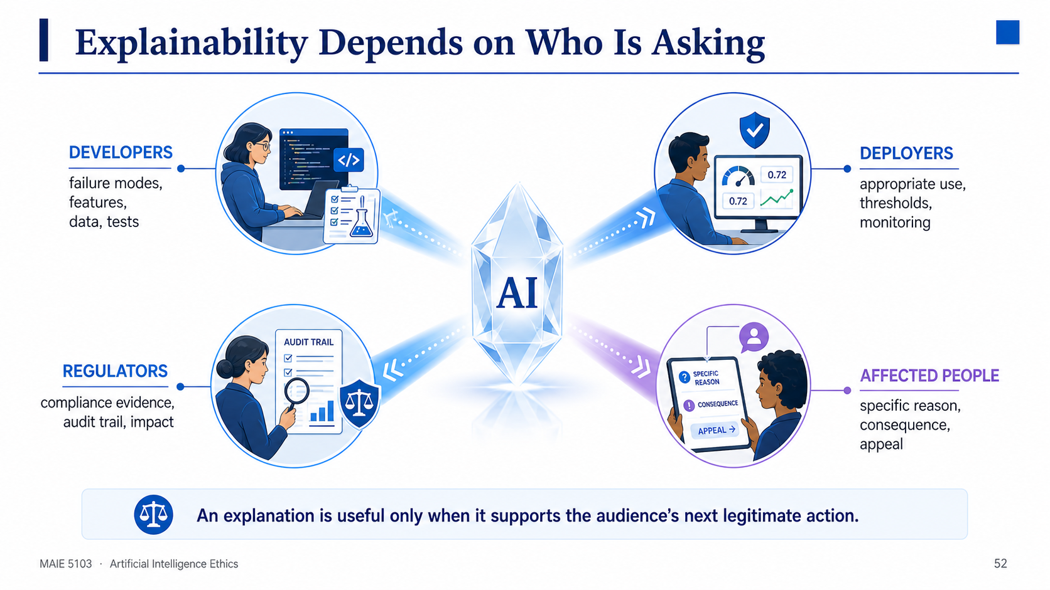
When AI harms, who answers?
Developer? Deployer? User? The machine itself?
Liability gaps and the “many hands” problem (recall Dignum, Slide 35).
Need: clear responsibility + redress / remedy mechanisms.
Notes:
Developers, deployers, regulators, and affected people need different explanations because each audience has a different legitimate next action.

Slide 53
Safety, Security & Reliability
Reliability: fails safely; robust to distribution shift.
Security: adversarial attacks, model extraction, data poisoning.
Dual use: the same tech can heal or harm (e.g., bio-research vs bio-risk; deepfakes).
High confidence ≠ reliability — test before you trust.
TEST
SECURE
MONITOR
RESPOND
Safety and security require testing before deployment and monitoring under real-world change after deployment.
MAIE 5103 · Artificial Intelligence Ethics
54
42
Notes:
Safety and security require testing before deployment and monitoring under real-world change after deployment. Use the visible source material on this slide to explain the idea in concrete terms, then connect it to the next step in the lecture. Invite students to test the claim against a familiar AI system rather than treating the principle as an abstract slogan.
[Sources]
- Source content and course structure: user-provided MAIE5103_Lecture1_all.pptx.

Slide 54
Broader Societal Impacts
Labor: automation & displacement; shifting skill demands.
Inequality & power: benefits concentrate; the poor are over-profiled (O’Neil, Eubanks).
Democracy: misinformation, polarization, manipulation.
Environment: energy & water footprint of large models.
INDIVIDUAL
INSTITUTION
SOCIETY
Aggregate benefits can coexist with concentrated harms, unequal power, and long-term institutional change.
MAIE 5103 · Artificial Intelligence Ethics
55
43
Notes:
Aggregate benefits can coexist with concentrated harms, unequal power, and long-term institutional change. Use the visible source material on this slide to explain the idea in concrete terms, then connect it to the next step in the lecture. Invite students to test the claim against a familiar AI system rather than treating the principle as an abstract slogan.
[Sources]
- Source content and course structure: user-provided MAIE5103_Lecture1_all.pptx.

Slide 55
Moral Status & AI Agency
A philosophical question (Coeckelbergh).
Moral patient: should we care about AI itself? (suffering? rights?)
Moral agent: can AI be held responsible? Most say no — no intent or consciousness.
Coeckelbergh’s relational view: moral status depends on relations & contexts, not fixed essence.
Practical focus: humans affected by AI bear the primary moral weight.
MORAL PATIENT
MORAL AGENT
HUMAN RESPONSIBILITY
Moral status asks whether AI can be harmed; moral agency asks whether it can be responsible — these are different questions.
MAIE 5103 · Artificial Intelligence Ethics
56
44
Notes:
Moral status asks whether AI can be harmed; moral agency asks whether it can be responsible — these are different questions. Use the visible source material on this slide to explain the idea in concrete terms, then connect it to the next step in the lecture. Invite students to test the claim against a familiar AI system rather than treating the principle as an abstract slogan.
[Sources]
- Source content and course structure: user-provided MAIE5103_Lecture1_all.pptx.

Slide 56
Debate: Can an AI System Be Morally Responsible?
Separate autonomy in operation from responsibility in the moral and legal sense.
ARGUMENT FOR
ARGUMENT AGAINST
Advanced systems can select actions, adapt, and operate beyond immediate human control. Responsibility concepts may need to evolve.
Systems lack human intentions, social membership, and moral understanding. Assigning responsibility to AI may let institutions evade accountability.
Even if agency remains contested, human institutions must still assign answerability and remedy.
MAIE 5103 · Artificial Intelligence Ethics
57
Notes:
Run a structured seven-minute debate. Ask one side to argue for expanded concepts of agency and the other to defend human and institutional responsibility. End by distinguishing philosophical status from practical accountability.
[Sources]
- Source course structure and baseline content: user-provided MAIE5103_Lecture1_all.pptx.

Slide 57
Case 1: Algorithmic Bias in Criminal Justice
COMPAS — recidivism risk scoring (O’Neil).
COMPAS: a recidivism-risk tool used in US sentencing and bail decisions.
ProPublica (2016): over-predicted recidivism for Black defendants; under-predicted for white.
Tensions: accuracy vs fairness; opacity; stakes = liberty.
Lesson: a “neutral” score encodes bias; criminal history acts as a proxy for race.
RISK SCORE
FAIRNESS CHOICE
LIBERTY IMPACT
The COMPAS debate shows that competing fairness definitions can produce different judgments from the same scores.
MAIE 5103 · Artificial Intelligence Ethics
58
45
Notes:
The COMPAS debate shows that competing fairness definitions can produce different judgments from the same scores. Use the visible source material on this slide to explain the idea in concrete terms, then connect it to the next step in the lecture. Invite students to test the claim against a familiar AI system rather than treating the principle as an abstract slogan.
[Sources]
- Source content and course structure: user-provided MAIE5103_Lecture1_all.pptx.

Slide 58
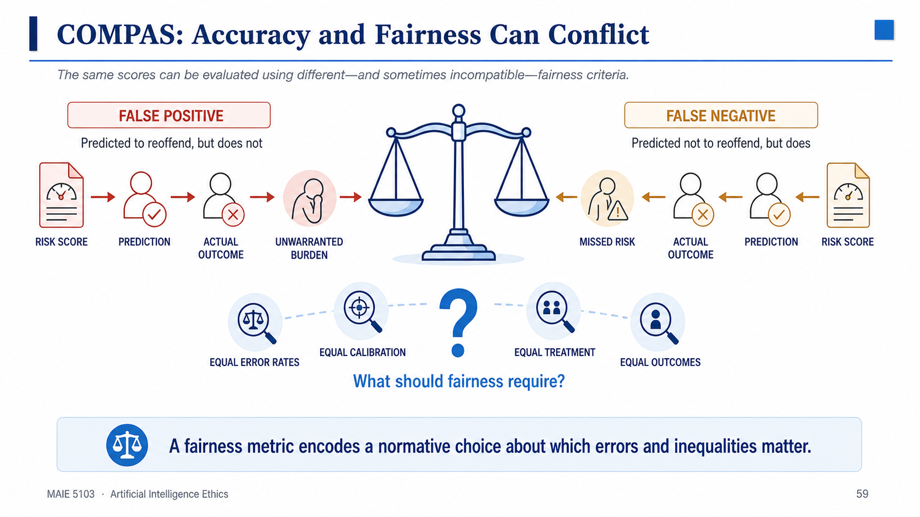
A person is predicted to reoffend but does not. ProPublica reported this error was more common for Black defendants in its analysis.
A person is predicted not to reoffend but does. ProPublica reported this error was more common for white defendants.
Discussion: Should fairness mean equal error rates, equal calibration, equal treatment, or equal outcomes?
Notes:
Explain the two error types before discussing fairness definitions. Do not imply that one metric mechanically resolves the dispute; each criterion foregrounds different harms and institutional goals.
[Sources]
- https://www.propublica.org/article/how-we-analyzed-the-compas-recidivism-algorithm
Contrast false positives and false negatives, then discuss why fairness definitions may conflict.

Slide 59
MAIE 5103 · LECTURE 1
Break 2
Return question: Which AI ethics issue is hardest to govern—and what makes it difficult?
15–20 MINUTES
MAIE 5103 · Artificial Intelligence Ethics
48
Notes:
Take the second 15–20 minute break. After the break, collect two responses and connect them to explainability, accountability, and the case studies that follow.
[Sources]
- Source course structure and baseline content: user-provided MAIE5103_Lecture1_all.pptx.

Slide 60
Case 2: Scoring the Poor
The “digital poorhouse” (Eubanks, 2018).
Three systems that profile, police, and punish the poor:
IN welfare-eligibility automation — benefits denied en masse.
Allegheny County child-welfare predictive-risk model.
LA coordinated-entry system for homelessness triage.
Patterns: proxies for poverty; little transparency or recourse; automation of austerity.
Lesson: the most vulnerable bear the most opaque, punitive AI.
APPLICATION
AUTOMATED GATE
APPEAL
Automation can scale administrative burden and denial when notice, human review, and appeal are weak.
MAIE 5103 · Artificial Intelligence Ethics
60
46
Notes:
Automation can scale administrative burden and denial when notice, human review, and appeal are weak. Use the visible source material on this slide to explain the idea in concrete terms, then connect it to the next step in the lecture. Invite students to test the claim against a familiar AI system rather than treating the principle as an abstract slogan.
[Sources]
- Source content and course structure: user-provided MAIE5103_Lecture1_all.pptx.

Slide 61
Case 3: WMDs in Hiring, Credit & Insurance
Three O’Neil cases.
Hiring
Resumé-screening models learn biased proxies (e.g., gendered terms).
Opaque + scaled + damaging.
Credit & insurance
Zip code as a proxy for race / risk; opaque pricing.
Opaque + scaled + damaging.
Teacher eval
Value-Added Models punish teachers for factors beyond their control.
Opaque + scaled + damaging.
HIRING
CREDIT
TEACHER EVAL
Proxy variables and feedback loops allow discrimination to persist even when protected attributes are removed.
Each fits O’Neil’s WMD criteria: opaque + at scale + damaging + proxy-driven.
MAIE 5103 · Artificial Intelligence Ethics
61
47
Notes:
Proxy variables and feedback loops allow discrimination to persist even when protected attributes are removed. Use the visible source material on this slide to explain the idea in concrete terms, then connect it to the next step in the lecture. Invite students to test the claim against a familiar AI system rather than treating the principle as an abstract slogan.
[Sources]
- Source content and course structure: user-provided MAIE5103_Lecture1_all.pptx.

Slide 62
Case 4: Facial Recognition & Surveillance
Buolamwini & Gebru (2018), Gender Shades: error far higher for darker-skinned women than lighter-skinned men.
Uses: unlock, tagging, access control.
Abuses: mass surveillance, wrongful arrest.
Harms: misidentification → wrongful arrest; chilling effect.
Need: accuracy equity, consent, and limits on use.
ACCURACY
LEGITIMACY
OVERSIGHT
Accuracy alone cannot justify surveillance; legitimacy also depends on purpose, consent, proportionality, and oversight.
MAIE 5103 · Artificial Intelligence Ethics
62
48
Notes:
Accuracy alone cannot justify surveillance; legitimacy also depends on purpose, consent, proportionality, and oversight. Use the visible source material on this slide to explain the idea in concrete terms, then connect it to the next step in the lecture. Invite students to test the claim against a familiar AI system rather than treating the principle as an abstract slogan.
[Sources]
- Source content and course structure: user-provided MAIE5103_Lecture1_all.pptx.

Slide 63
Gender Shades: Intersectional Evaluation Changes the Result
Aggregate accuracy can hide severe subgroup disparities.
34.7%
0.8%
Lighter-skinned men
maximum error
Darker-skinned women
maximum error
Reported maxima across the commercial systems evaluated in the 2018 study
Disaggregate performance by intersecting groups before concluding that a system is accurate or fair.
MAIE 5103 · Artificial Intelligence Ethics
63
Notes:
The paper reported error rates up to 34.7% for darker-skinned women and a maximum of 0.8% for lighter-skinned men across the evaluated commercial gender-classification systems. Emphasize the evaluation method: subgroup analysis exposed disparities hidden by aggregate results.
[Sources]
- https://proceedings.mlr.press/v81/buolamwini18a

Slide 64
Case 5: Deepfakes, Misinformation & Generative AI
Cheap, convincing synthetic audio / video / images.
Harms: non-consensual intimate imagery; election disinformation; erosion of trust (“the liar’s dividend”).
Generative AI lowers the cost of fakes; detection is an arms race.
Need: provenance / watermarking, media literacy, platform policy.
CREATE
DISTRIBUTE
VERIFY
RESPOND
Deepfake governance needs layered responses: provenance, detection, platform policy, law, literacy, and victim support.
MAIE 5103 · Artificial Intelligence Ethics
64
49
Notes:
Deepfake governance needs layered responses: provenance, detection, platform policy, law, literacy, and victim support. Use the visible source material on this slide to explain the idea in concrete terms, then connect it to the next step in the lecture. Invite students to test the claim against a familiar AI system rather than treating the principle as an abstract slogan.
[Sources]
- Source content and course structure: user-provided MAIE5103_Lecture1_all.pptx.

Slide 65
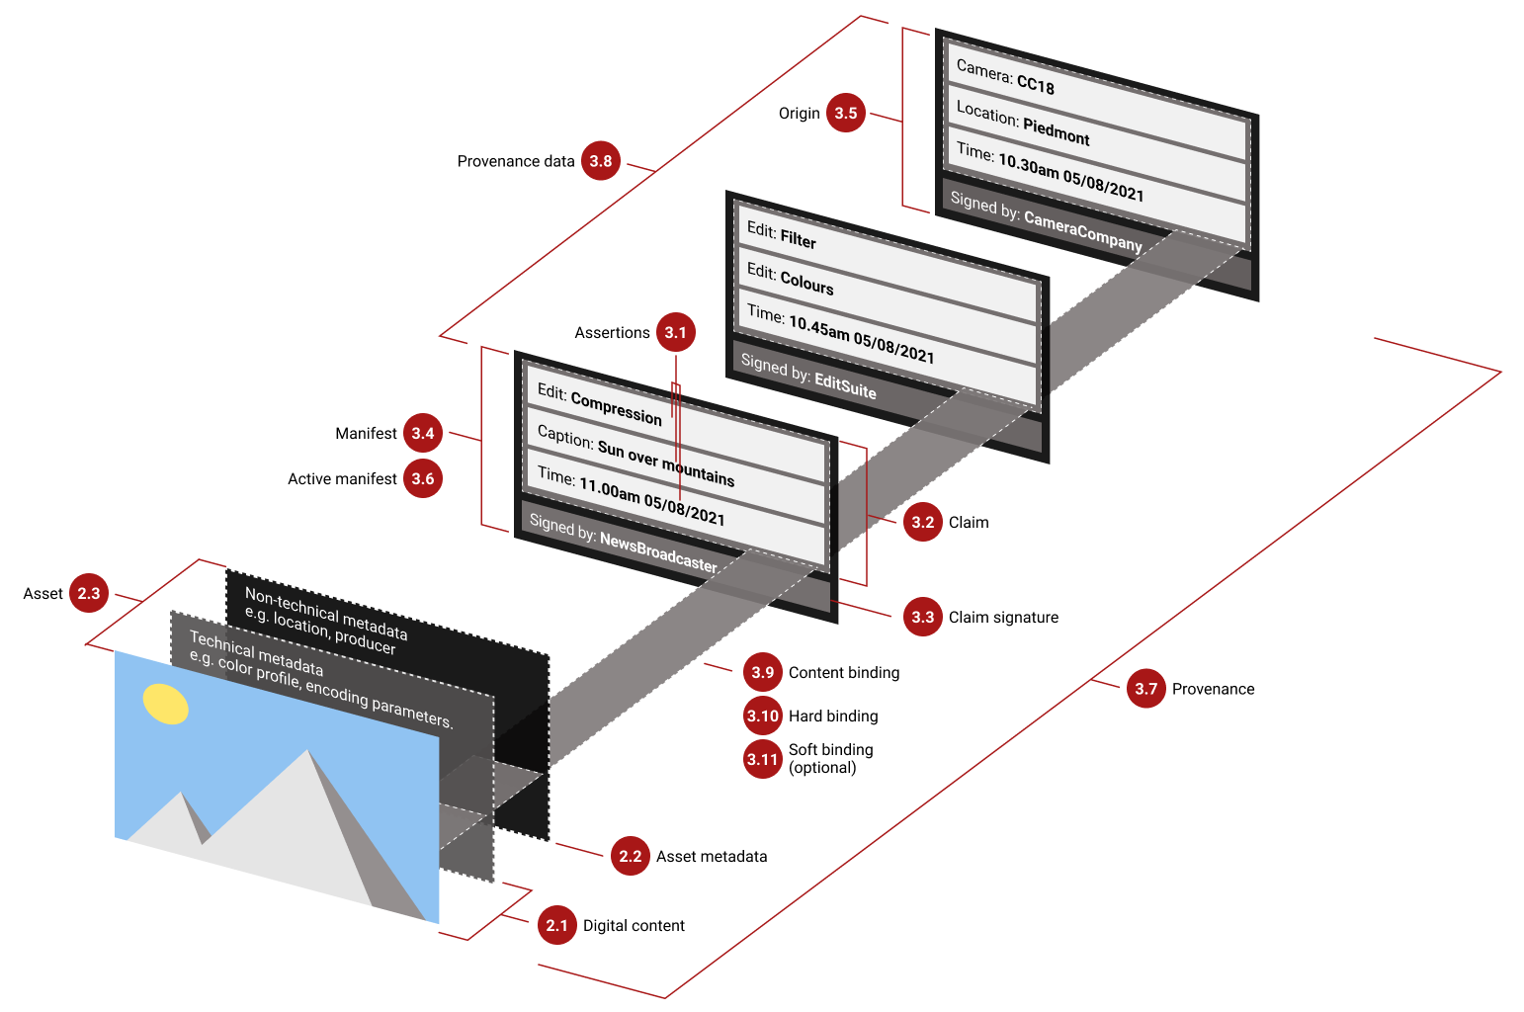
Content Provenance: What C2PA Can—and Cannot—Prove
Signed provenance can record origin and edits, but it does not certify truth.
• A manifest can bind claims and signatures to an asset.
• Edit history helps users inspect provenance and detect tampering.
• Authentic provenance can still accompany misleading content.
Provenance supports verification; it does not replace contextual judgment or fact-checking.
MAIE 5103 · Artificial Intelligence Ethics
65
Notes:
Walk through the official diagram from digital content and metadata to signed manifests and provenance. Then state the limitation clearly: a valid chain can show where content came from and how it changed, but not whether the represented claim is true.
[Sources]
- https://spec.c2pa.org/specifications/specifications/1.0/specs/C2PA_Specification.html

Slide 66
Case 6: Autonomous Systems — Vehicles & Weapons
Autonomous vehicles: split-second harm; the Moral Machine experiment shows cross-cultural variation.
Lethal autonomous weapons (LAWS): machines that select targets.
Responsibility gap: who is liable / accountable for an autonomous decision?
Stakes: life-and-death decisions delegated to opaque systems.
VEHICLES
WEAPONS
HUMAN CONTROL
Vehicles and weapons differ in purpose, but both raise questions about meaningful human control and accountability.
MAIE 5103 · Artificial Intelligence Ethics
66
50
Notes:
Vehicles and weapons differ in purpose, but both raise questions about meaningful human control and accountability. Use the visible source material on this slide to explain the idea in concrete terms, then connect it to the next step in the lecture. Invite students to test the claim against a familiar AI system rather than treating the principle as an abstract slogan.
[Sources]
- Source content and course structure: user-provided MAIE5103_Lecture1_all.pptx.

Slide 67
Structured Debate: Meaningful Human Control
Compare autonomous vehicles and lethal autonomous weapons without assuming they are ethically equivalent.
AUTONOMOUS VEHICLES
AUTONOMOUS WEAPONS
PURPOSE
mobility and safety
selection and use of force
TIME PRESSURE
collision avoidance
targeting and engagement
HUMAN ROLE
design, supervision, takeover
authorization, judgment, abort
FAILURE IMPACT
injury and public safety
life, conflict, international law
ACCOUNTABILITY
manufacturer, operator, regulator
commanders, states, developers
Meaningful control requires timely information, genuine authority, and an identifiable responsible actor.
MAIE 5103 · Artificial Intelligence Ethics
67
Notes:
Give students one position to defend: what conditions would make human control meaningful rather than symbolic? Compare purpose, time pressure, authority, and failure consequences before reaching a conclusion.
[Sources]
- Source course structure and baseline content: user-provided MAIE5103_Lecture1_all.pptx.

Slide 68
“Responsible AI” — the Triad
Dignum: Responsible AI is socio-technical.
Responsible AI = Responsibility + Design + Governance.
Who is responsible: agency & accountability across the pipeline.
What we design: values-by-design — ethics built into the system.
How we govern: oversight, auditing, and redress.
Integrates ethics across the whole lifecycle, not just the code.
RESPONSIBILITY
DESIGN
GOVERNANCE
Responsible AI links who is accountable, what is designed, and how governance verifies performance in practice.
MAIE 5103 · Artificial Intelligence Ethics
68
51
Notes:
Responsible AI links who is accountable, what is designed, and how governance verifies performance in practice. Use the visible source material on this slide to explain the idea in concrete terms, then connect it to the next step in the lecture. Invite students to test the claim against a familiar AI system rather than treating the principle as an abstract slogan.
[Sources]
- Source content and course structure: user-provided MAIE5103_Lecture1_all.pptx.

Slide 69
Ethical Principles for AI
Many frameworks converge on a core set (Floridi et al.).
Beneficence: do good — promote well-being.
Non-maleficence: do no harm.
Autonomy: preserve human agency and choice.
Justice: fair and equitable.
Explicability: intelligible and accountable.
Also: EU Ethics Guidelines, UNESCO, OECD AI Principles.
BENEFICENCE
AUTONOMY
JUSTICE
EXPLICABILITY
Ethical principles work best as review questions that guide design evidence, not as slogans.
MAIE 5103 · Artificial Intelligence Ethics
69
52
Notes:
Ethical principles work best as review questions that guide design evidence, not as slogans. Use the visible source material on this slide to explain the idea in concrete terms, then connect it to the next step in the lecture. Invite students to test the claim against a familiar AI system rather than treating the principle as an abstract slogan.
[Sources]
- Source content and course structure: user-provided MAIE5103_Lecture1_all.pptx.

Slide 70
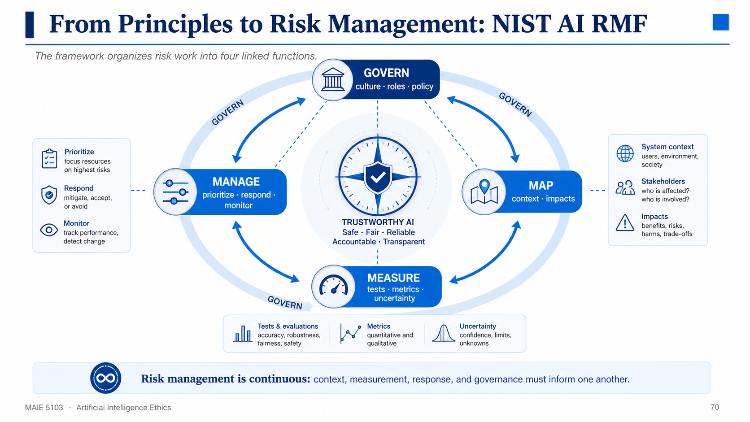
Notes:
MAP, MEASURE, and MANAGE form a continuous operating cycle; GOVERN shapes culture, roles, and policy across the entire framework.
Introduce NIST AI RMF 1.0 as a voluntary, rights-preserving, non-sector-specific framework. Explain that Govern is cross-cutting, while Map, Measure, and Manage create an iterative operational cycle.
[Sources]
- https://www.nist.gov/publications/artificial-intelligence-risk-management-framework-ai-rmf-10

Slide 71
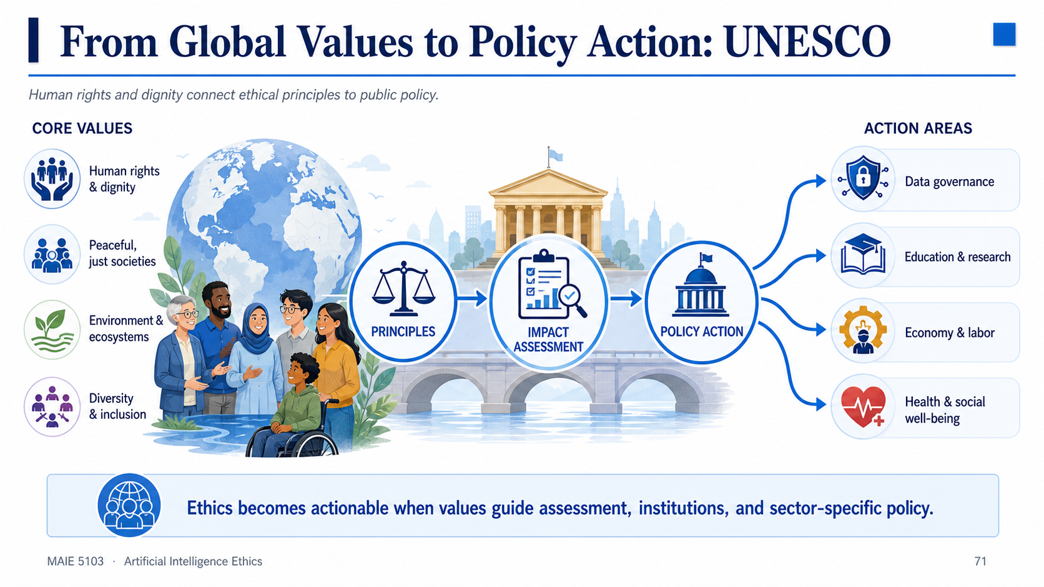
Notes:
Replacement for original page 71. Values and principles become actionable through impact assessment, institutions, and sector-specific policy.
CORE VALUES
Human rights & dignity
Peaceful, just societies
Environment & ecosystems
Diversity & inclusion
ACTION AREAS
Data governance
Education & research
Economy & labor
Health & social well-being
[Sources]
- https://www.unesco.org/en/articles/recommendation-ethics-artificial-intelligence?hub=66929

Slide 72
Common Tensions & Trade-offs
Principles rarely give a single answer.
Accuracy ↔ Fairness
Privacy ↔ Utility
Transparency ↔ IP / Security
Innovation ↔ Precaution
Automation ↔ Human dignity / oversight
Trade-offs require judgment + context.
ACCURACY ↔ FAIRNESS
PRIVACY ↔ UTILITY
INNOVATION ↔ PRECAUTION
Trade-offs should be demonstrated, documented, and monitored — not assumed before better options are explored.
MAIE 5103 · Artificial Intelligence Ethics
72
53
Notes:
Trade-offs should be demonstrated, documented, and monitored — not assumed before better options are explored. Use the visible source material on this slide to explain the idea in concrete terms, then connect it to the next step in the lecture. Invite students to test the claim against a familiar AI system rather than treating the principle as an abstract slogan.
[Sources]
- Source content and course structure: user-provided MAIE5103_Lecture1_all.pptx.

Slide 73
A Practical Ethical Decision-Making Framework
1. Identify stakeholders & affected groups.
2. Map values & potential harms (benefits, risks, rights).
3. Apply ethical lenses (consequentialist, deontological, virtue, justice).
4. Generate & compare options.
5. Decide, document & justify (accountability).
6. Monitor & review (iterative).
STAKEHOLDERS
HARMS & VALUES
OPTIONS
DECIDE
MONITOR
A defensible decision identifies stakeholders, maps harms, applies lenses, compares options, justifies action, and monitors outcomes.
MAIE 5103 · Artificial Intelligence Ethics
73
54
Notes:
A defensible decision identifies stakeholders, maps harms, applies lenses, compares options, justifies action, and monitors outcomes. Use the visible source material on this slide to explain the idea in concrete terms, then connect it to the next step in the lecture. Invite students to test the claim against a familiar AI system rather than treating the principle as an abstract slogan.
[Sources]
- Source content and course structure: user-provided MAIE5103_Lecture1_all.pptx.

Slide 74
Applying the Framework
Walkthrough: an AI hiring tool.
The case
A tool that screens resumés and ranks applicants.
Stakeholders
Applicants (esp. minorities), employer, society.
Harms / values
Bias, privacy, fairness, efficiency.
Applying the 6 steps
3– Lenses: justice; non-maleficence.
4. Options: deploy / audit-first / human-in-loop / don’t deploy.
5. Decision: audit + human review + document.
6. Monitor: adverse-impact ratios; retrain; review.
AUDIT
REDESIGN
HUMAN REVIEW
MONITOR
For a hiring tool, audit and redesign before deployment is often more defensible than deploying first and repairing harm later.
MAIE 5103 · Artificial Intelligence Ethics
74
55
Notes:
For a hiring tool, audit and redesign before deployment is often more defensible than deploying first and repairing harm later. Use the visible source material on this slide to explain the idea in concrete terms, then connect it to the next step in the lecture. Invite students to test the claim against a familiar AI system rather than treating the principle as an abstract slogan.
[Sources]
- Source content and course structure: user-provided MAIE5103_Lecture1_all.pptx.

Slide 75
Capstone Exercise: Ethical Review of an AI Hiring Tool
Work in groups: 10 minutes analysis + 5 minutes debrief.
1 Stakeholders
2 Evidence needed
3 Benefits & harms
4 Ethical lenses
5 Options
6 Decision
7 Monitoring
8 Remedy
Deliverable: a two-sentence recommendation, the evidence that could change it, and one safeguard for affected applicants.
A defensible ethical review links values to evidence, options, accountability, and remedy.
MAIE 5103 · Artificial Intelligence Ethics
75
Notes:
Give groups ten minutes to complete the eight-part review and five minutes for debrief. Require a provisional decision, not only a list of concerns. Ask what evidence could reverse the decision and how rejected applicants would receive an explanation and appeal.
[Sources]
- Source course structure and baseline content: user-provided MAIE5103_Lecture1_all.pptx.

Slide 76
Limits of Principles & the Need for Governance
Principles are necessary but not sufficient.
They can’t resolve hard trade-offs or prevent “ethics washing”.
Need governance & regulation: audits, liability, standards, oversight.
“Ethics is the floor; law / governance is the enforceable structure.”
Preview: Week 11 — AI Policy & Regulations.
PRINCIPLES
STANDARDS
ENFORCEMENT
REMEDY
Principles set direction; governance assigns authority, incentives, evidence requirements, enforcement, and remedy.
MAIE 5103 · Artificial Intelligence Ethics
76
56
Notes:
Principles set direction; governance assigns authority, incentives, evidence requirements, enforcement, and remedy. Use the visible source material on this slide to explain the idea in concrete terms, then connect it to the next step in the lecture. Invite students to test the claim against a familiar AI system rather than treating the principle as an abstract slogan.
[Sources]
- Source content and course structure: user-provided MAIE5103_Lecture1_all.pptx.

Slide 77
How This Course Approaches AI Ethics
Case-based learning: real cases ground abstract principles.
Weekly readings: the five books + Canvas resources.
Active participation: discussions, quizzes, AI news presentations.
Capstone: final project — report + presentation.
Each upcoming week deep-dives one theme from today’s map.
ENCOUNTER
ANALYZE
DEBATE
DECIDE
REFLECT
The course repeatedly practices a cycle: encounter a case, analyze it, debate options, decide, and reflect.
MAIE 5103 · Artificial Intelligence Ethics
77
57
Notes:
The course repeatedly practices a cycle: encounter a case, analyze it, debate options, decide, and reflect. Use the visible source material on this slide to explain the idea in concrete terms, then connect it to the next step in the lecture. Invite students to test the claim against a familiar AI system rather than treating the principle as an abstract slogan.
[Sources]
- Source content and course structure: user-provided MAIE5103_Lecture1_all.pptx.

Slide 78
Key Takeaways
AI is powerful + opaque + pervasive → ethics is essential.
Multiple ethical lenses illuminate different facets of a problem.
Principles converge, but implementation is hard and governance matters.
Real cases (O’Neil, Eubanks) show harms fall hardest on the vulnerable.
You will build your own ethical-reasoning toolkit over the term.
AI CHARACTERISTICS
ETHICAL LENSES
GOVERNANCE
Responsible AI requires both ethical reasoning and institutional mechanisms that make responsibility real.
MAIE 5103 · Artificial Intelligence Ethics
78
58
Notes:
Responsible AI requires both ethical reasoning and institutional mechanisms that make responsibility real. Use the visible source material on this slide to explain the idea in concrete terms, then connect it to the next step in the lecture. Invite students to test the claim against a familiar AI system rather than treating the principle as an abstract slogan.
[Sources]
- Source content and course structure: user-provided MAIE5103_Lecture1_all.pptx.

Slide 79
Reading, Next Lecture & Q&A
Read: Coeckelbergh (intro) + O’Neil Ch.1 (released on Canvas).
Next: Lecture 2 — Privacy and Data Protection.
Reflect: “Name an AI system you use daily — what ethical questions does it raise?”
Thank you! Questions are welcome.
siruihan@ust.hk · Office hours: TBD
MAIE 5103 · Artificial Intelligence Ethics
79
59
Notes:
For discussion: name one AI system, one affected stakeholder, one possible harm, and one practical safeguard. Use the visible source material on this slide to explain the idea in concrete terms, then connect it to the next step in the lecture. Invite students to test the claim against a familiar AI system rather than treating the principle as an abstract slogan.
[Sources]
- Source content and course structure: user-provided MAIE5103_Lecture1_all.pptx.

Slide 80
HKUST · MSc(AIE) Program · Fall 2026/27
Thank you!
Q&A
1
Notes:
Learn to recognize ethical risks before they become real-world harms. Use the visible source material on this slide to explain the idea in concrete terms, then connect it to the next step in the lecture. Invite students to test the claim against a familiar AI system rather than treating the principle as an abstract slogan.
[Sources]
- Source content and course structure: user-provided MAIE5103_Lecture1_all.pptx.

